Slide 1
Analytics Rest API and Telematics Dashboard Widgets Project Onboarding KT & Strategy

Slide 2
History of Element & Current Vision
Industrial Age → Information Age → Internet Age → Social & Sharing Age → AI Age
GE Capital USA Fleet Acquisition
Largest Fleet Data Aggregator
GE Capital Canada Fleet Acquisition
Company Found
TLS Canada Acquisition
CEI Acquisition
PHH Arval
USA
2007
2012
2013
2014
2015
2017

Slide 3
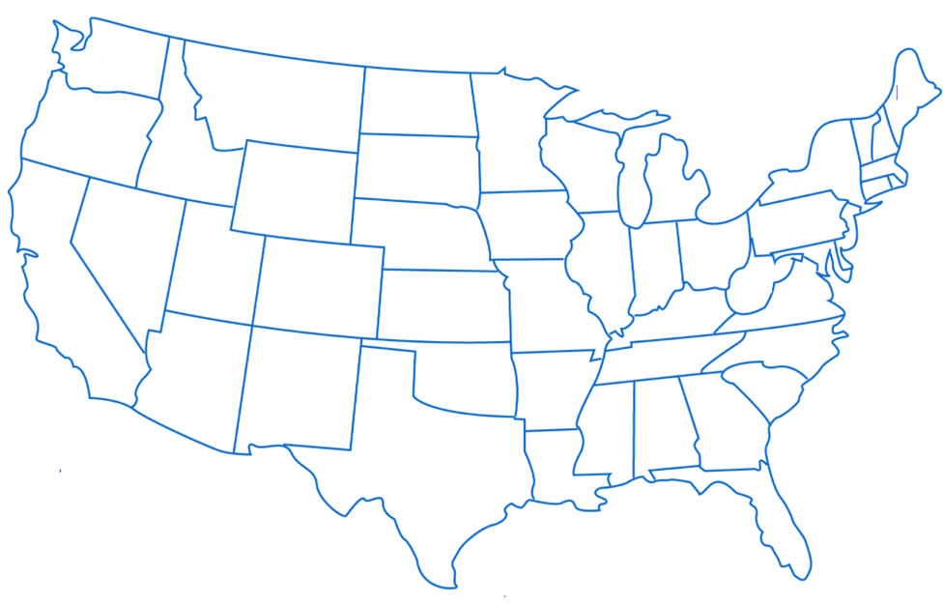
Potential Opportunities
Total Assets:
Telematics Equipped: 135 K
USA, Canada, Mexico
Fuel Consumption
Maintenance
Temperature
Vendor Network
Traffic
Accidents
Utilization
Scalable Infrastructure to store and analyze data. Provide data services to clients, vendors Etc

Slide 4
Example Data Aggregators & Data Growth
Data Aggregators ???
Current Asset Data Growth Projections
~ 1 TB per year Non-Telematics Data
~ 1 TB per Month Telematics Data

Slide 5
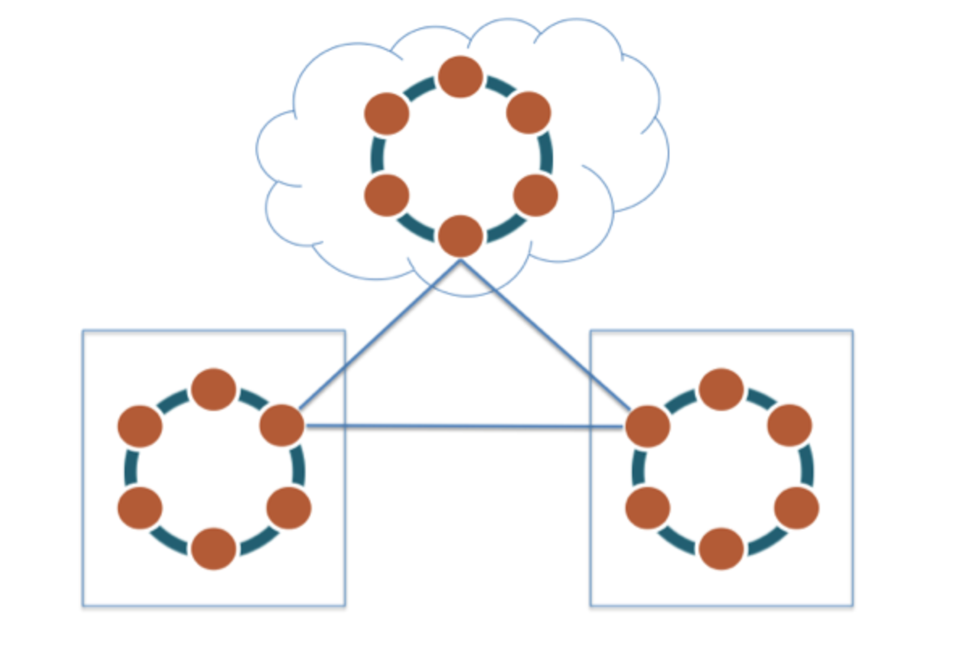
Apache Cassandra Database Platform
Highly Scalable
Highly Available
Handles High Velocity Writes
Distributed
Though it lacks many many features in RDBMS, the purpose of NoSQL database is to handle high volume, velocity and scalability.
Current Big Data Industry is rebuilding tools from ground up to handle Big Data volumes, storage, performance. New features are being added every year through open source community.

Slide 6
Moore’s Law
Moore is Co-Founder of Inter. He has made and observation and predicted that
“Processing power of a single core will double every year by doubling transistors per square inch in a circuit”
Moore’s law on a single core has stalled around 2005. Performance for a core stalled at 3Ghz.
Moore’s law is being achieved now by adding more cores to the processor.
We can only add so many CPU cores to single computer. So, high volume workloads require Horizontal Scaling. That means we add more servers to the handle the workload.
We are in a era of Distributed Computing. New programing paradigms for concurrency, Parallelism etc. New programming languages and databases being invented to work in a distributed environment.

Slide 7
Element Cassandra Foot Print
Cassandra was introduced in 2015.
Went live at the end of 2016.
Current Production Nodes 117
2018 Projection → ~180 nodes

Slide 8
Summary – Element History
Element Fleet has grown to be largest Fleet Provider in North America through acquisitions.
Creating a Consolidation platform on Cassandra database with an aim to become largest Fleet Data Aggregator in the world.
More asset growth is expected through organic and non-organic means.

Slide 9
API Journey

Slide 10



















Analytics Logical Architecture Future State
TRADITIONAL BI &
REPORTING
EXPLORATION &
VISUALIZATION
ADVANCED ANALYTICS
CUSTOM ANALYTICS
APPLICATIONS
TBD
Tableau/Qlik/
DreamUp/etc
Reports
Dashboards
Visualization
Level 1
Discovery
Mobile
Web
ODBC/
JDBC
API LAYER (REST/JSON)
ANALYTICS ENGINE
SQL LAYER
SEARCH
STREAMING
ON-DEMAND
SCHEDULED
ANALYTICAL DATASTORE
FiloDB
DATA INGESTION
STREAMING
BATCH
Informatica/Talend/Other?
EXTERNAL DATA
INTERNAL DATA

Slide 11

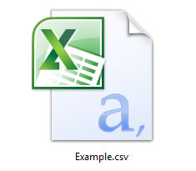
Analytics Rest API Use Cases
Dashboard Widgets
Data Exploration
Large Extracts
External API
outbound
External API
Inbound
Power BI
Reports
Dashboards
Reports
Dashboards
Downloads
Restful Services API LAYER
ANALYTICAL DATASTORE
Cassandra
Spark
FiloDB

Slide 12
API Implementation Roadmap
External API
Inbound
External API
Outbound
Large File Extract
Power BI
Telematics
Widgets Project
Infrastructure & Foundation
July
August
September

Slide 13
Technology Stack for Implementing Rest API
Akka & Akka-HTTP
Open Source
Is a Scala Library
Part of SMACK stack
Distributed Computing
Actor Model
Concurrent
Scalable
Non Blocking IO
Back Pressure Management
High level DSL abstractions
Load balancing
Persistence
Supervision
Lightbend Reactive Platform
Open Source with Supporting Model
Scala
Akka, Akka-HTTP
Standalone Play, Spray

Slide 14
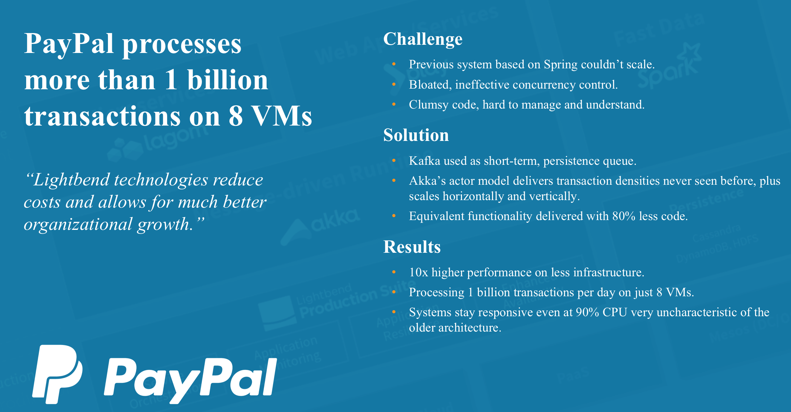
Akka Success Stories

Slide 15
Analytics Restful API Architecture
Rest API call
Restful Services API LAYER
Akka Cluster is made up of nodes.
Node is a single JVM process
We can add more nodes, with different roles anywhere in our infrastructure.
We are building Restful API services on our own.
Node Role:
HTTP Services
VM
4 cores
16 GB RAM
CentOS
Akka Http
Akka Http
ANALYTICAL DATASTORE
Node Role:
Data actors
Cassandra
Spark
FiloDB

Slide 16
Key Terms for API Developers
Blocking Call
Non-Blocking Call
Synchronous
Asynchronous
Concurrency
Parallelism
Multi-thread programming
Actor Model
Futures
Using Akka actor model, futures and Cassandra Java Driver non-blocking asynchronous calls makes a good combination for achieving high concurrency and throughput than traditional JDBC driver based databases.
Ex: Blocking calls can fit ~4096 threads in 1 GB memory
~2.7 million actors can fit in 1 GB memory.
Reference: SMACK is a popular tech stack in Big Data space.

Slide 17
Element Analytics API Journey
Discussions Started in April-May
Spring Boot vs Akka Comparison
Akka was chosen for asynchronous, non-blocking, parallelism, scalability, extensive open source library availability etc.
POC Completed July – Sept 9th

Slide 18
Dashboard Widget API’s
Dashboard Widgets
Data Exploration
Large Extracts
External API
outbound
External API
Inbound
Power BI
Reports
Dashboards
Reports
Dashboards
Downloads
Restful Services API LAYER
ANALYTICAL DATASTORE
Cassandra
Spark
FiloDB

Slide 19
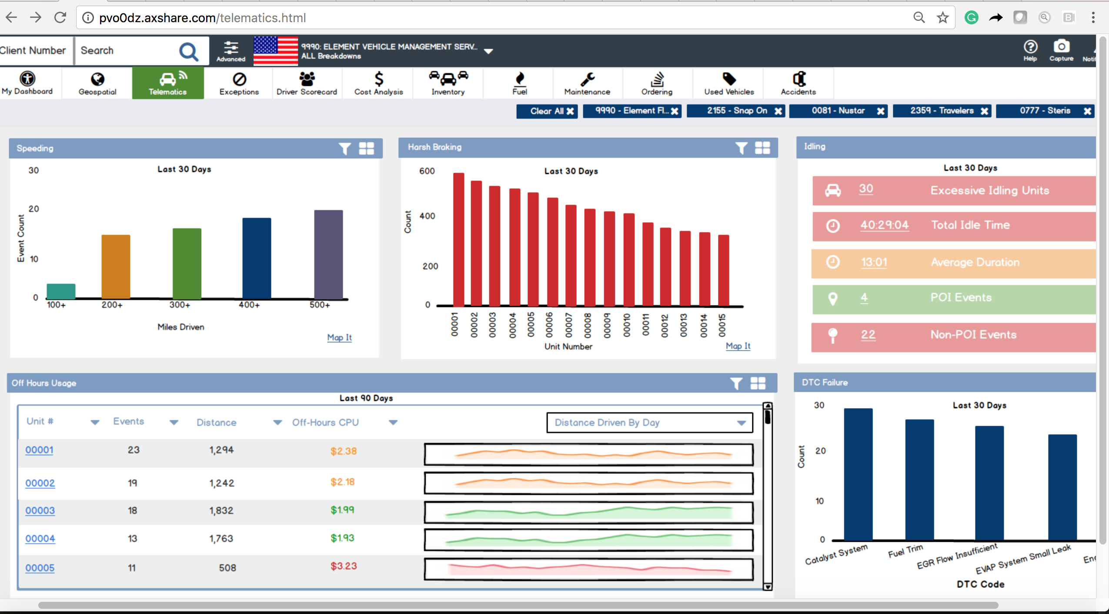
Ex: Telematics Dashboard

Slide 20
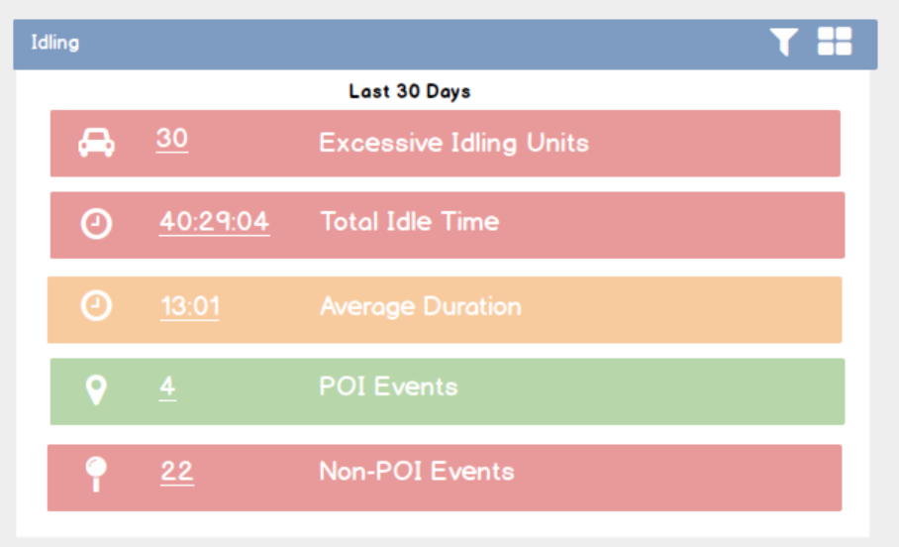
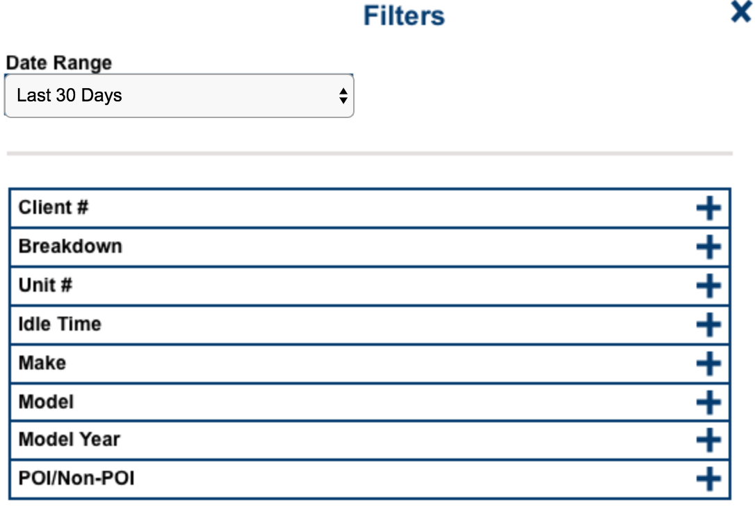
Widget & Filter
API Resource Definition: An Entity/Process/Transaction/Summary at a predefined grain level.
An API can be used by any client that is authorized to use the API. Ex: Xcelerate, Custom application, Power BI, Third party (coming soon)
Ref: There are existing Xcelerate dashboard widget API’s that use SPIN as data source.

Slide 21
API Request & Response
http://vsplarapi01d.fleet.ad:8090/v1/telematics/idling/summary
Method: Post
Payload:
{ "filters": { "corpCd": [ "FA" ], "clientNo": [ "6403" ], "dateRange":["Last 30 Days"], "breakdown":["000COR-000COR-000COR-0T8005-000850"] }, "columns": [ "clientNo","corpCd","idlePctTotEngineHrs","dateRange","totalEstIdleCost","totalIdleDuration","totalIdleNonPoiEvents","totalIdlePoiEvents","totalIdleDurationFormatted","avgIdleDurationFormatted","breakdown" ], "sort": [ {"col":"corpCd", "orderBy":"asc"}, {"col":"clientNo","orderBy":"asc"} ], "offset": 0, "limit": 0}
Response:
{ "status": { "message": "Success", "statusCode": "200" }, "result": { "totalRecords": 1, "noOfRowsFetched": 1, "records": [ { "breakdown": "000COR-000COR-000COR-0T8005-000850", "avgIdleDurationFormatted": "0:11:39", "totalIdlePoiEvents": 13, "totalEstIdleCost": "5.870034239999999", "clientNo": "6403", "totalIdleDuration": "186.4", "idlePctTotEngineHrs": "5.604430627130977", "corpCd": "FA", "totalIdleNonPoiEvents": 7, "dateRange": "Last 30 Days", "totalIdleDurationFormatted": "3:06:24" } ] }}
Supported Syntax:
Filter, Group By, Sort, Pagination, Column Selection

Slide 22
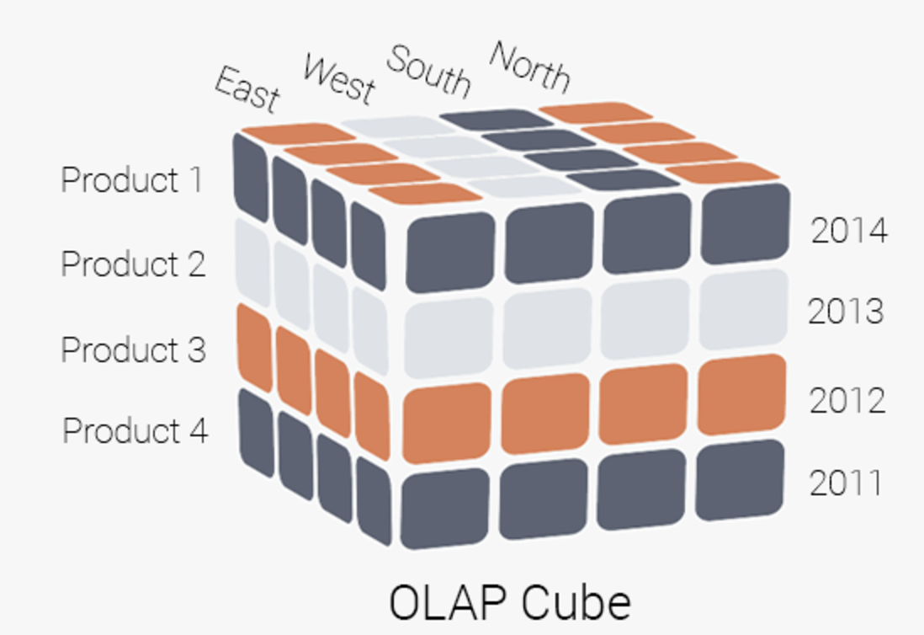
Analytics API Features
Slicing & Dicing
Aggregation
Sorting
Filtering
Very similar to OLAP Cube type of functionality

Slide 23
API SLA’s & Pre-Aggregated Data
Customers expect low latency
Dashboard Response Time SLA ??? (waiting for non-functional requirements)
We are going to leverage pre-aggregated datasets as much as possible to meet SLA’s. Reducing on the fly filtering and aggregation of transaction gain level data and is key to achieving high performance.
Low Latency will lead to high concurrency support as well.
Next few slides will describe current options and strategy explored during POC.

Slide 24

Performance SLA & Concurrency Challenge
Queries at Peak load = concurrent users landing on dashboards * number of widgets to be rendered on landing page
(hypothetical example)
200 Users * 6 queries per page = 1200 queries
Individual query SLA = 3 seconds
SLA’s define the throughput that we need to produce from the tech stack. (API + Database)
Non functional requirements will define our horizontal scaling needs (if any).

Slide 25
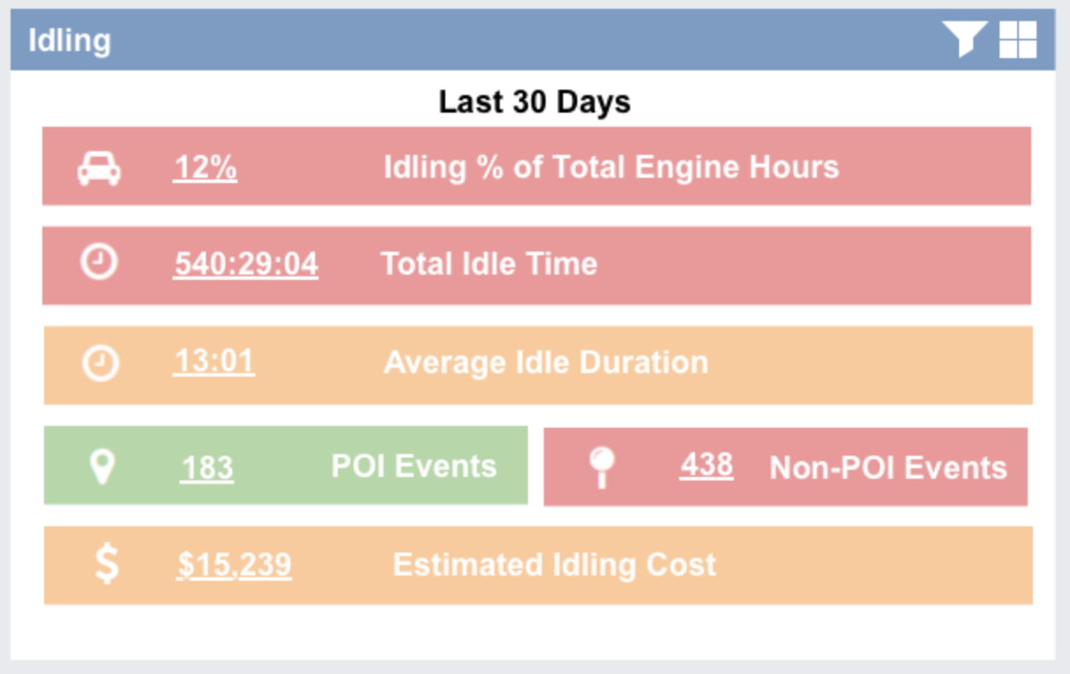
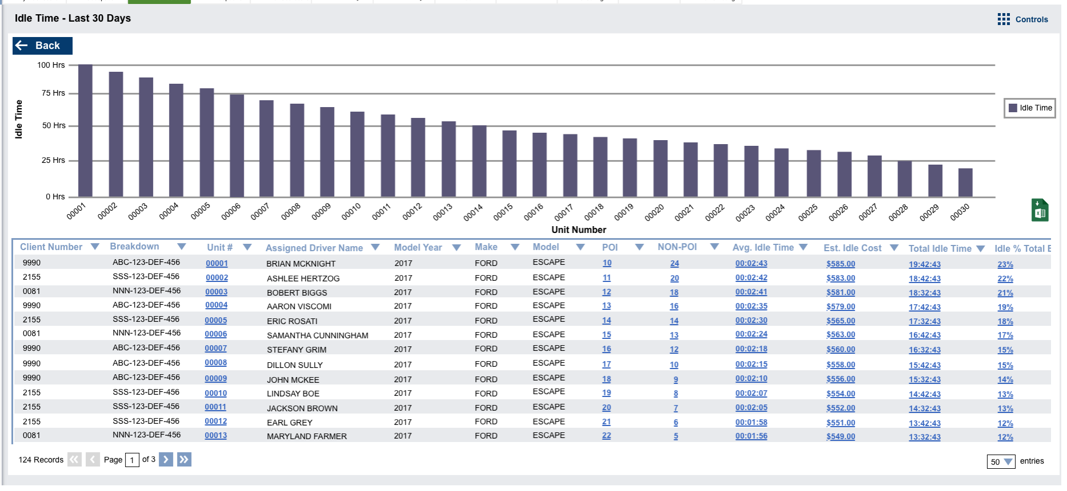
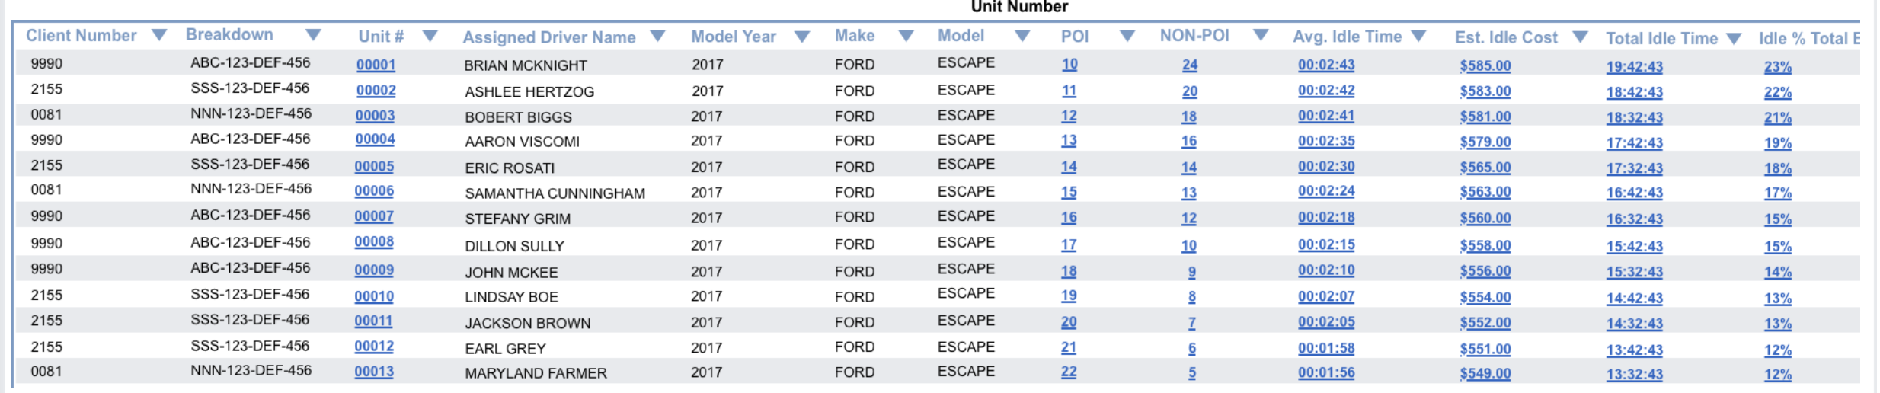
Example: Widget With 2 Drill Through Levels
Wider Data Ranges/low cardinality dimensions, High level summary
Summary Data1
In some cases, same API/Summary table can serve multiple levels. That is what happened in our POC.
Strike the right balance between SLA’s & tables
Narrowing Data Ranges/ low cardinality dimensions, Little more detail
Summary Data2
Transaction Level Data
Narrow date range/specific filters high cardinal dimensions, lot more details
Requirements/Design: Avoid setting up top level widget on top of transaction grain at all costs. General flow should be from pre-aggregated Summary views to transactional detail views

Slide 26
Dashboard Widgets - Summary
Build client agnostic API’s
Achieve low latency and high concurrency requirements using Cassandra/Spark/FiloDB/Thrift platform
Provide valuable insights for Fleet Management.

Slide 27
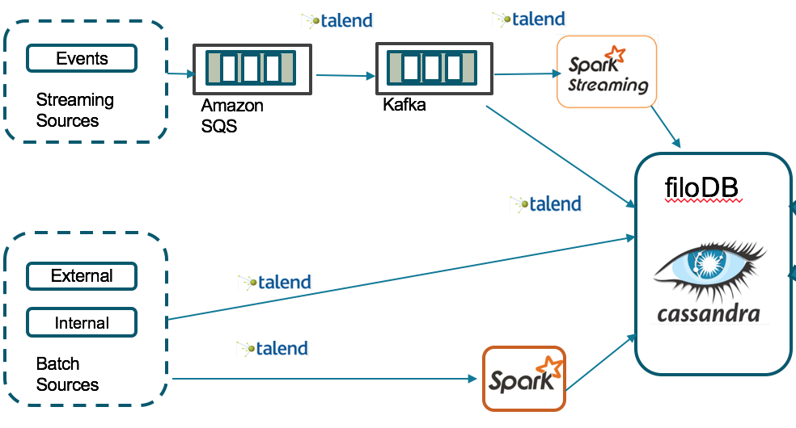

ETL Approach taken during POC
Traditional Element Cassandra/FiloDB ADS ETL Flow.
POC didn’t use Talend for processing Cassandra/FiloDB data as it may not be the efficient tool of choice for moving data within the cluster.
ETL Leads can review this strategy and make any necessary changes as they see fit.
This strategy will define our go forward summary tables/data mart strategy for upcoming dashboard projects.
Spark Shell script
/ FiloDB
/ FiloDB

Slide 28
Data Sources and Data Modeling Strategies Explored in POC
Cassandra (No SQL) Data Modeling Methods. (Prepare the data for how it is going to be consumed.)
Single Table (No-JOINs)
(User row level data security checks???)
Exceptions: Transaction level details
API Clients
Data Sources
Cassandra (Ideal & Preferred, may not be feasible in all cases)
FiloDB via Thrift
More details in following slides
Restful API Services Layer
C* Table
Via Thrift
FiloDB Table
Strike the right balance between using Cassandra as source vs Thrift. We have estimated that ~70% Dashboard API will go toward thrift and ~30% will go toward Cassandra. If we invent the right sharding technique we could change the balance.
Exceptions
Transaction Details
Via thrift

Slide 29
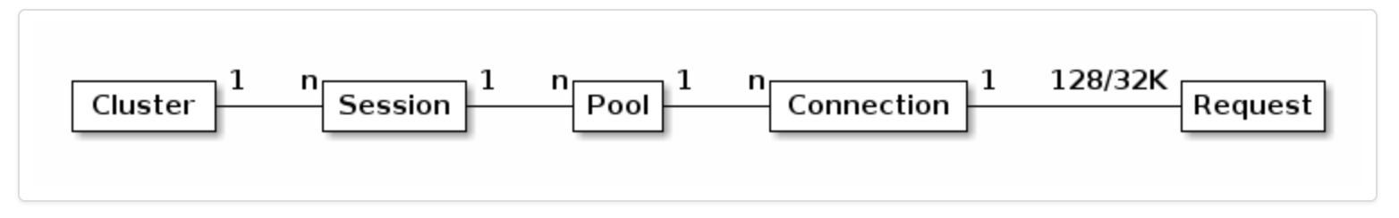
Cassandra Data Source
Cassandra is our ticket for supporting high concurrency.
Cassandra java driver comes with Asynchronous API and connection pooling and load balancing strategies.
Cassandra java driver establishes connections to all the nodes/hosts creating huge data pipe.
Cassandra + Akka actor model + Futures will give us the ability to run massive number of queries in production.
C* Java
Driver
One Java driver session has a connection pool per each host in the cluster.
One Java driver session can hold up to 32k requests across the cluster

Slide 30
Cassandra Challenges/Opportunities – POC Findings
This is our first venture into directly leveraging Cassandra for reading data.
Cassandra has great write throughput.
Cassandra read performance is also excellent for small size data.
Cassandra query latency increases as the size of the data/partition it is reading increases.
Cassandra does not support JOIN operation or aggregation. They will have to done in API code.
Challenge/Opportunity → Find ideal sharding technique to sub-partition data to meet Dashboard SLA’s. Use Akka futures and design patterns to read data from multiple partitions in parallel to achieve low latency.
We have conducted ~25 load tests recently to gain insights into Cassandra behavior with respect to small partition vs large partition performance.
Additional Java Driver Tuning options need to be explored.
Cassandra performance beats thrift server performance & concurrency levels hands down when using partitions and Akka concurrency model.

Slide 31
Cassandra Data Source -- Summary
High Concurrency and query throughput is possible if you can figure out appropriate partitioning strategy.
Cassandra Data Source strategy works for small partition tables.
Cassandra based API requires lot more coding and tuning to handle client side filtering, aggregation, sorting and pagination.
Coding complexity may prevent us from leveraging Cassandra API in most cases, however there is lot to take advantage of if we can solve challenges.

Slide 32
Spark (Thrift Server) & Concurrency

Slide 33
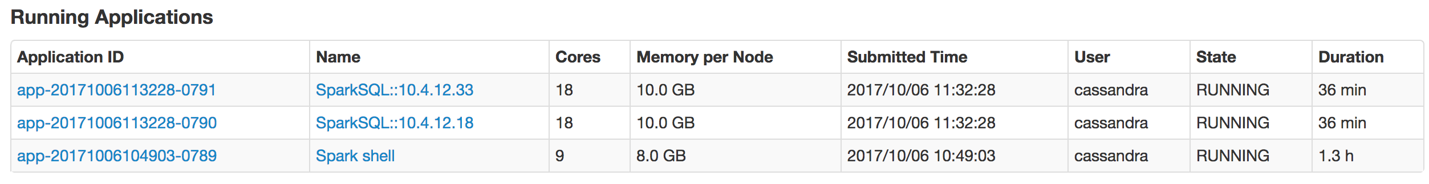
Thrift Resources & Query Execution
Thrift Server is allocated a defined set of resources
CPU
Memory

Slide 34
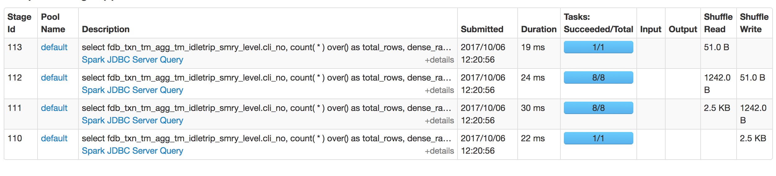
Thrift Query Plan
Catalyst Optimizer decides the number of tasks needed to execute the query based on the query plan.
Each tasks need a certain amount of CPU time based on the cycle time

Slide 35
Thrift Resources & Query Concurrency
Concurrent SQL Queries
Spark Query Engine
Catalyst Optimizer & Scheduler
Queries per second =
CPU cores / (Query tasks * Avg task time in ms)
Example 1: 18 cores, 18 tasks, 100 ms
18 / (18 * .1) = 10 QPS (queries per second)
Example: 18 cores, 1 task, 50 ms
18 / (1*0.05) = 360 QPS (queries per second)
Overload Queue
Wait time increases query latency
Thrift Server CPU cores & Capacity

Slide 36
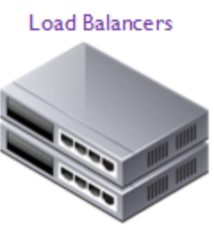
Scaling Out Thrift Servers
Queries per second =
CPU cores / (Query tasks * Avg task time in ms)
1 Thrift server
Avg query 60 tasks, 100 ms
126 / (60 * .1) = 210 qps
3 Thrift server = 630 qps
Thrift 1
126 Cores
Thrift 2
126 Cores
Thrift 3
126 Cores
Production Thrift Servers

Slide 37
Key Take Away
Reducing tasks per query and reducing task duration (sometimes harder) is key behind achieving Thrift Server scalability.
Overloading Thrift Servers will cause queries sit in a queue until resources become available.
The amount of time a query spends in scheduler queue will add to query latency. This will not show up in thrift monitor logs, only client application would notice this additional latency.

Slide 38
Dashboard Widget API Data Modeling for Thrift Server
Single Table is a great way to reduce number of tasks.
Single Partition or fewer partitions will require fewer tasks.
Thrift API is are query based. It can be easily configured for a single table or join query (Transaction Details).
Leverage Spark SQL features, less client side code.
More pushdown predicates and pushdown aggregation capabilities

Slide 39
Data Sources Summary
Leverage both Cassandra and Thrift Server Data Sources
Cassandra Partitioning Strategy is different for Spark-Cassandra use case vs non-Spark use cases.
Spark-Cassandra requires fewer larger partitions and other use cases may require more smaller partitions.
Review Non-functional requirements
Review Cluster Utilization Metrics
Scale Horizontally to meet demands if necessary.

Slide 40
Additional Work Loads on Sparks DC
BO Thrift Queries
Net new API thrift queries +
Cassandra queries
Telematics FiloDB reporting tables. Real time
New ETL read/write workloads to support API tables
Cassandra + Spark Cluster
SPIN ETL mostly batch +
few real time ingestion jobs
This project team will find optimal ways to model and accommodate new work loads coming on to the cluster. Horizontally scale cluster if required. Bring new ideas into shaping up existing DSE infrastructure. There are plans to modify the cluster and setup a brand new Telematics cluster. Learn about new work loads, assess impact on proposed cluster setup, change it if necessary.

Slide 41
API Development Strategy
Dashboard Widget/ Data API’s support below features
Column Selection
Filtering – Pre Aggregation
Aggregation
Filtering – Post Aggregation
Sort
Limit
In SQL terms
“Select …....
from table
where ...
group by
having ...
order by ...
Limit
“
2 Flavors of API Framework
Cassandra Source based API
Spark-SQL/Thrift query based API (join supported)
Both API’s will offer same features except that their data source is different.
Reusable metadata driven framework
Scala, Akka, Akka HTTP
Thrift API framework is 75% ready
Cassandra API framework requires more coding, complex to build. Cassandra Table/Model should have predictable sharding keys as Cassandra doesn’t support partial predicates.

Slide 42

Development Activity & Coordination
UI Team: Dashboard, Widgets, Filters, API Calls
Overall: PM,Scrum Master
QA & Load testing
Operations
Key Stakeholders
API Dev Team: API Framework
BA, Users: Business Requirements
DA/ ETL: Data Modeling, ETL, Performance tuning, Cluster workload management, archiving/purging, scheduling, Documentation, Telematics domain expertise

Slide 43
Appendix
Martin Odersky, "Working Hard to Keep It Simple" - OSCON Java 2011 ...

Slide 44
Other Useful Information
Stick to summary tables as much as possible.
Avoid hitting transaction details for high level summaries (Level 1,2 etc.)
Use non-functional requirements (SLA) as your guide to decide what’s a reasonable requirement and what’s not.
There is cost for making everything real time or near real time. Remind business of the costs of their ask. Provide reasoning and they will be reasonable.
Having too little details makes analytics useless, on the other hand having too many details makes it too slow and unusable. Find the right balance.

Slide 45
Restful API Definition
A RESTful web service/API is a web service implemented using HTTP and the principles of REST. It is a collection of resources, with below aspects:
Base URI (ex: http://example.com/resources/)
Internet Media Type
HTTP methods supported (Get,Put,Post,Delete)
Rest API supports a resource.
Ex: Analytics Data API → Supports a entity/process/transaction at defined grain level.

